Slide 1
_{Low level prototyping}

Slide 2
PROTOTYPING
What is a prototype?
Why prototype?
Different kinds of prototyping
low fidelity
high fidelity
Tools for low fidelity prototyping

Slide 3
FOUR BASIC ACTIVITIES IN INTERACTION DESIGN
  Establishing requirements
  Designing alternatives
  Prototyping
  Evaluating
Iterate!

Slide 4
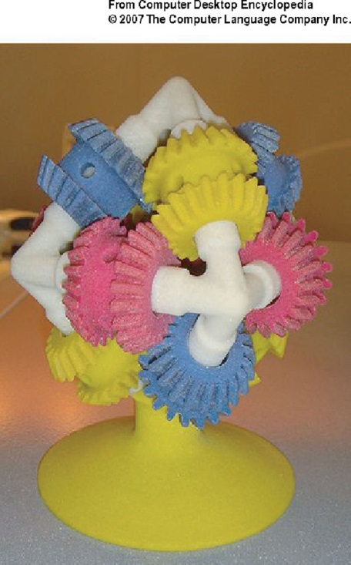
WHAT IS A PROTOTYPE?
In other design fields a prototype is a small-scale model:
  a miniature car
  a miniature building or town
  the example here comes
  from a 3D printer

Slide 5
WHAT IS A PROTOTYPE?
In interaction design it can be (among other things):
  a series of screen sketches
  a storyboard, i.e. a cartoon-like series of scenes
  a Powerpoint slide show
  a video simulating the use of a system
  a lump of wood (e.g. PalmPilot)
  a cardboard mock-up
  a piece of software with limited functionality written in the target language or in another language

Slide 6
WHY PROTOTYPE?
Evaluation and feedback are central to interaction design
Stakeholders can see, hold, interact with a prototype more easily than a document or a drawing
Team members can communicate effectively
You can test out ideas for yourself
It encourages reflection: very important aspect of design
Prototypes answer questions, and support designers in choosing between alternatives

Slide 7
WHAT TO PROTOTYPE?
  Technical issues
  Work flow, task design
  Screen layouts and information display
  Difficult, controversial, critical areas

Slide 8
LOW-FIDELITY PROTOTYPING
Uses a medium which is unlike the final medium, e.g. paper, cardboard
Is quick, cheap and easily changed
Examples:
sketches of screens, task sequences
‘Post-it’ notes
storyboards
‘Wizard-of-Oz’

Slide 9
STORYBOARDS
Often used with scenarios, bringing more detail, and a chance to role play
It is a series of sketches showing how a user might progress through a task using the device
Used early in design

Slide 10
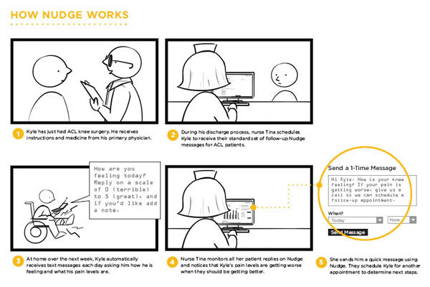

Slide 11
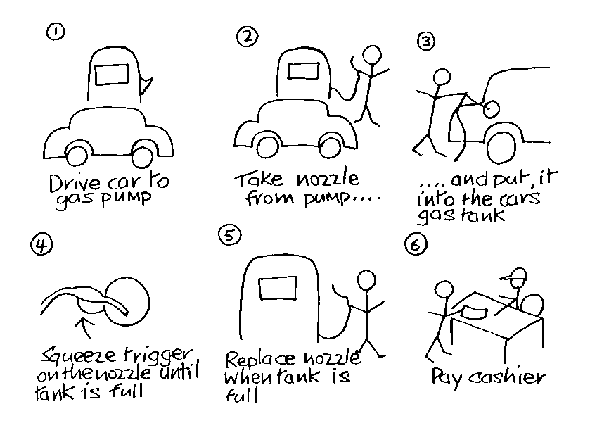
SKETCHING
Sketching is important to low-fidelity prototyping
Don’t be inhibited about drawing ability. Practice simple symbols
www.id-book.com

Slide 12
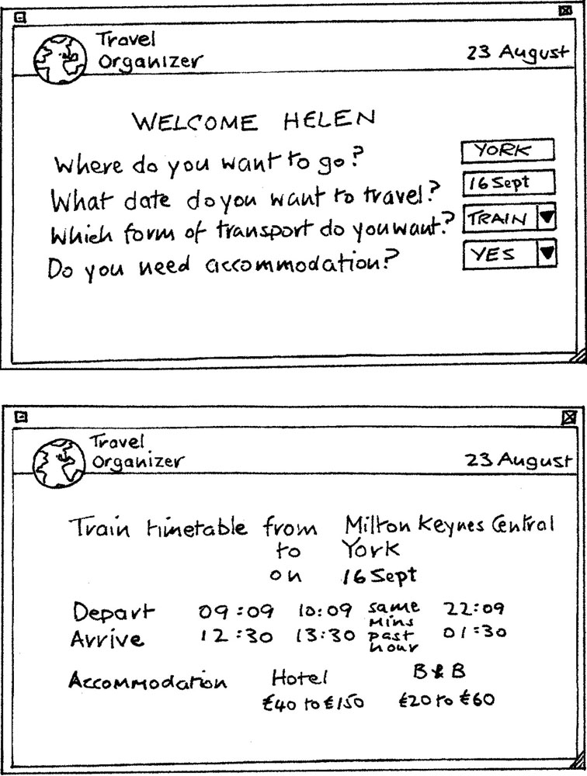
CARD-BASED PROTOTYPES
  Index cards (3 X 5 inches)
  Each card represents
  one screen or part of screen
  Often used in website
  development
www.id-book.com

Slide 13
‘WIZARD-OF-OZ’ PROTOTYPING
The user thinks they are interacting with a computer, but a developer is responding to output rather than the system.
Usually done early in design to understand users’ expectations
User
>Blurb blurb
>Do this
>Why?

Slide 14
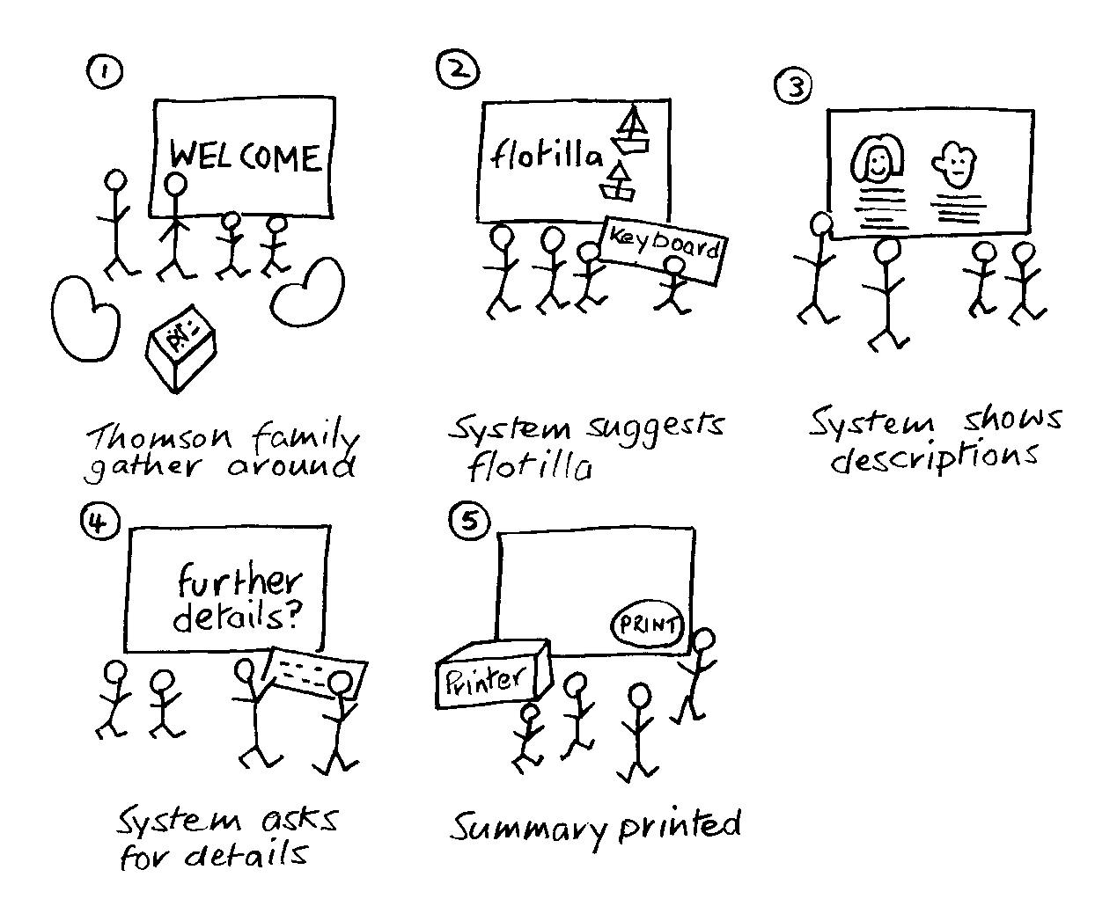
USING PROTOTYPES IN DESIGN:
GENERATE STORYBOARD FROM SCENARIO
www.id-book.com

Slide 15
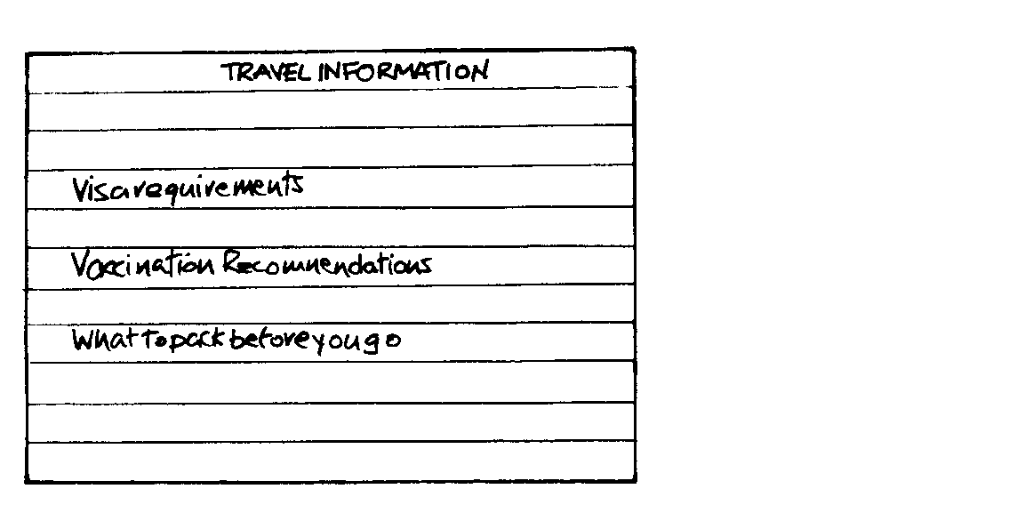
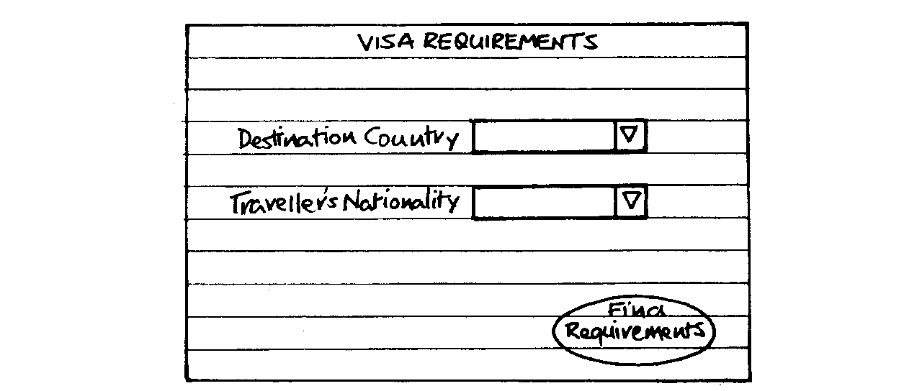

GENERATE CARD-BASED PROTOTYPE FROM USE CASE
Using prototypes in Design:
Generate card-based prototype from use case
www.id-book.com

Slide 16
CONCEPTUAL DESIGN: FROM REQUIREMENTS TO DESIGN
Transform user requirements/needs into a conceptual model
“a description of the proposed system in terms of a set of integrated ideas and concepts about what it should do, behave and look like, that will be understandable by the users in the manner intended”
Don’t move to a solution too quickly. Iterate, iterate, iterate
Consider alternatives: prototyping helps

Slide 17
IS THERE A SUITABLE METAPHOR?
Interface metaphors combine familiar knowledge with new knowledge in a way that will help the user understand the product.
Three steps: understand functionality, identify potential problem areas, generate metaphors
Evaluate metaphors:
    How much structure does it provide?
    How much is relevant to the problem?
    Is it easy to represent?
    Will the audience understand it?
    How extensible is it?

Slide 18
CONSIDERING INTERACTION TYPES
Which interaction type?
    How the user invokes actions
    Instructing, conversing, manipulating or exploring
Do different interface types provide insight?
    WIMP, shareable, augmented reality, etc

Slide 19
USING SCENARIOS IN CONCEPTUAL DESIGN
Express proposed or imagined situations
Used throughout design in various ways
  as a basis for overall design
  as scripts for user evaluation of prototypes
  as concrete examples of tasks
  as a means of co-operation across
  professional boundaries
Plus and minus scenarios to explore extreme cases
What if…?

Slide 20

MOVING FROM CONCEPTUAL TO PHYSICAL
We gradually expand/’flesh out’/add detail to the conceptual model.
If you have a conceptual prototype (most likely low fidelity like a storyboard or cards), you can create more detailed sketches, or move towards high fidelity prototypes.
It is a gradual process, not always clear exactly when conceptual becomes physical.
Conceptual
Physical

Slide 21
EXPANDING THE CONCEPTUAL MODEL
What functions will the product perform?
    What will the product do and what will the human do (task allocation as per essential user cases)?
    How much user customisation?
How are the functions related to each other?
    Sequential or parallel?
    Categorisations, e.g. all actions related to telephone memory storage
What information needs to be available?
    What data is required to perform the task?
    How is this data to be transformed by the system?
Physical Design

Slide 22
SUMMARY
Different kinds of prototyping are used for different purposes and at different stages
Prototypes answer questions, so prototype appropriately
Conceptual design (the first step of design)
Consider metaphors, interaction types and interface types to prompt creativity
Move from conceptual to physical design.

